Slide 1
Fourier Analysis
Dr. Vinod Veera Reddy

Slide 2
Periodic signals
Notes:
Fundamental Period
Fundamental frequency

Slide 3
Correlation?
Notes:
Fundamental Period
Fundamental frequency

Slide 4
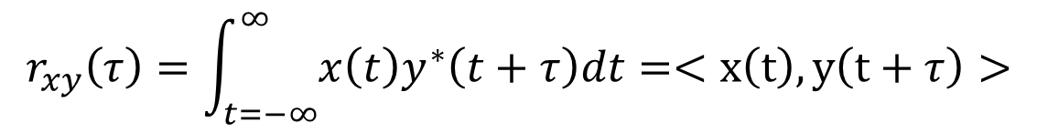
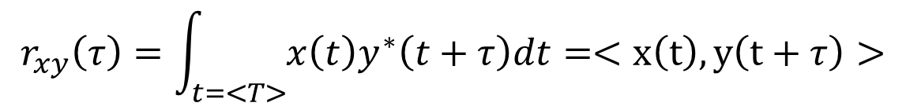
Pre-requisite - Correlation
Correlation
$$r_{xy}\left(τ\right)=\int_{t=−∞}^{∞}{x\left(t\right)y^{∗}\left(t+τ\right)dt}=<x\left(t\right),y\left(t+τ\right)>$$
Aperiodic signals
$$r_{xy}\left(τ\right)=\int_{t=<T>}{x\left(t\right)y^{∗}\left(t+τ\right)dt}=<x\left(t\right),y\left(t+τ\right)>$$
Periodic signals
What is the difference between Convolution & Correlation?
Notes:
Fundamental Period
Fundamental frequency

Slide 6
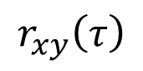
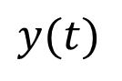
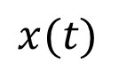
Pre-requisite - Correlation
Correlation
$$r_{xy}\left(τ\right)=\int_{t=−∞}^{∞}{x\left(t\right)y^{∗}\left(t+τ\right)dt}=<x\left(t\right),y\left(t+τ\right)>$$
Aperiodic signals
$$r_{xy}\left(τ\right)=\int_{t=<T>}{x\left(t\right)y^{∗}\left(t+τ\right)dt}=<x\left(t\right),y\left(t+τ\right)>$$
Periodic signals
Example 1
$$x(t)$$
$$y(t)$$
$$r_{xy}\left(τ\right)$$
Notes:
Fundamental Period
Fundamental frequency

Slide 7
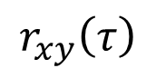
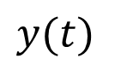
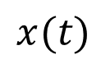
Pre-requisite - Correlation
Example 2
$$x(t)$$
$$y(t)$$
$$r_{xy}\left(τ\right)$$
Notes:
Fundamental Period
Fundamental frequency

Slide 8
Pre-requisite - Correlation
Example 3
$$x(t)$$
$$y(t)$$
$$r_{xy}\left(τ\right)$$
Notes:
Fundamental Period
Fundamental frequency

Slide 9
Observations:
When the signal perfectly matches with the template, a maximum is seen
A high correlation is also observed if the template partially matches
The maximum value is dependent
Active template duration
How closely does the template match the signal
Question: Why are we studying correlation NOW?

Slide 10
Frequency analysis of a signal
Question: What is a good mechanism to study frequency contents of a signal?
More Questions:
What is frequency?
What is the frequency content of a sine or cosine wave?
What are the basic signals in the time domain?
Are there any basic signals in the frequency domain?
Do we have any characteristics for basic signals in the frequency domain?
Compact and unambiguous representation in the frequency domain
A basic signal should be an eigen function of an LTI system

Slide 11
Frequency analysis of a signal
Do we have any characteristics for basic signals in the frequency domain?
Compact and unambiguous representation in the frequency domain
A basic signal should be an eigen function of an LTI system

Slide 12
Motivation
Signal analysis using basis signals
Complex sinusoids with various frequencies are used as basis signals
Frequency analysis marginally changes depending on the signal
Periodic or aperiodic
Continuous-time or discrete-time

Slide 13
Continuous-time Fourier Series

Slide 14
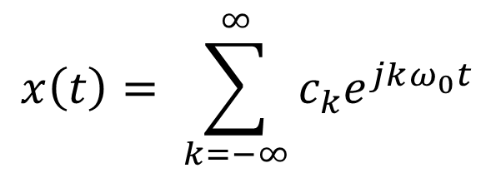
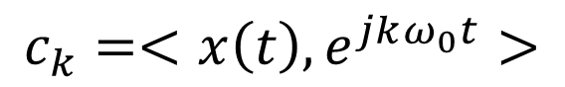
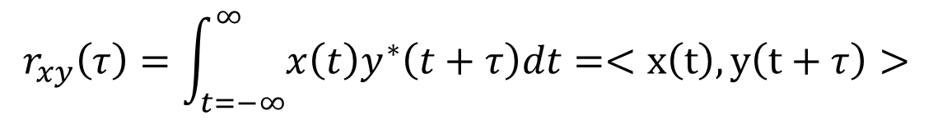
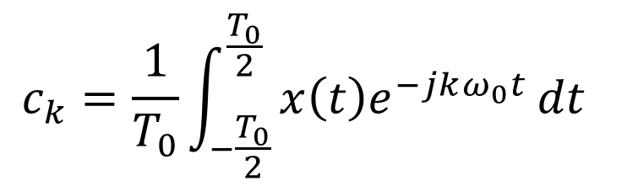
Complex exponential Fourier series representation
$$x\left(t\right)= \sum_{k=−∞}^{∞}{c_{k}e^{jkω_{0}t}}$$
$$c_{k}=\frac{1}{T_{0}}\int_{−\frac{T_{0}}{2}}^{\frac{T_{0}}{2}}{x\left(t\right)e^{−jkω_{0}t}}dt$$
$$r_{xy}\left(τ\right)=\int_{t=−∞}^{∞}{x\left(t\right)y^{∗}\left(t+τ\right)dt}=<x\left(t\right),y\left(t+τ\right)>$$
Correlation
CTFS:
$$c_{k}=<x\left(t\right),e^{jkω_{0}t}>$$

Slide 15
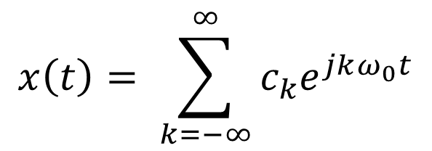
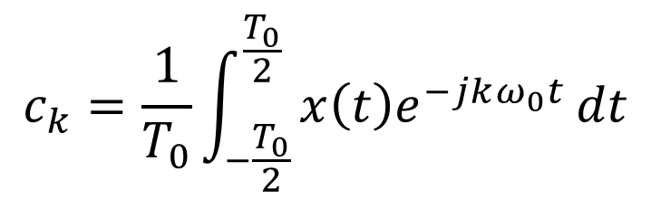
Complex exponential Fourier series representation
$$x\left(t\right)= \sum_{k=−∞}^{∞}{c_{k}e^{jkω_{0}t}}$$
$$c_{k}=\frac{1}{T_{0}}\int_{−\frac{T_{0}}{2}}^{\frac{T_{0}}{2}}{x\left(t\right)e^{−jkω_{0}t}}dt$$

Slide 16
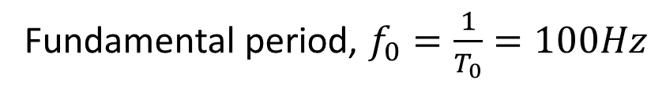
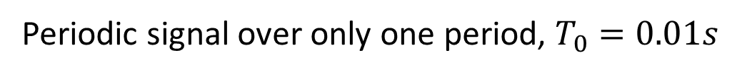
CTFS illustration
Periodic signal
Periodic signal over only one period, $T_{0}=0.01s$
Fundamental period, $f_{0}=\frac{1}{T_{0}}=100Hz$

Slide 17
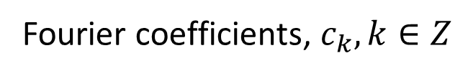
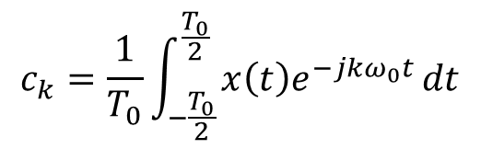
CTFS illustration
$$c_{k}=\frac{1}{T_{0}}\int_{−\frac{T_{0}}{2}}^{\frac{T_{0}}{2}}{x\left(t\right)e^{−jkω_{0}t}}dt$$
Fourier coefficients, $c_{k}, k∈Z$
Notes:
X-axis in the figure can be represented as frequency as well

Slide 18
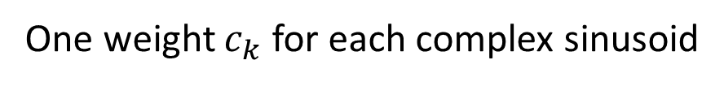
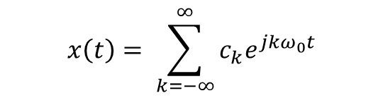
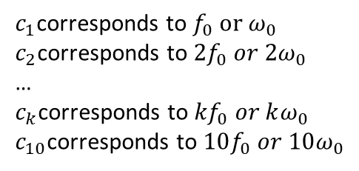
CTFS illustration
$$c_{k}=\frac{1}{T_{0}}\int_{−\frac{T_{0}}{2}}^{\frac{T_{0}}{2}}{x\left(t\right)e^{−jkω_{0}t}}dt$$
Fourier coefficients, $c_{k}, k∈Z$
$c_{1}$corresponds to $f_{0} or ω_{0}$
$c_{2}$corresponds to $2f_{0} or 2ω_{0}$
…
$c_{k}$corresponds to ${kf}_{0} or kω_{0}$
$c_{10}$corresponds to $10f_{0} or 10ω_{0}$
$$x\left(t\right)= \sum_{k=−∞}^{∞}{c_{k}e^{jkω_{0}t}}$$
One weight $c_{k}$ for each complex sinusoid
$k=17$ corresponds to which frequency in the above example?
Notes:
X-axis in the figure can be represented as frequency as well

Slide 19
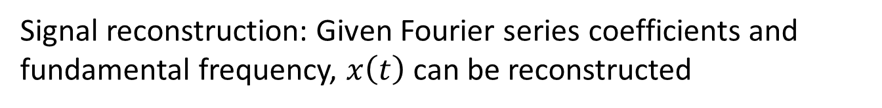
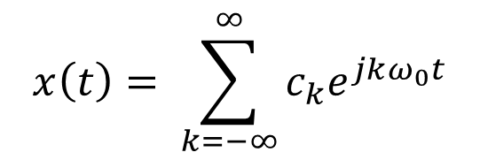
CTFS illustration
Signal reconstruction: Given Fourier series coefficients and fundamental frequency, $x\left(t\right)$ can be reconstructed
$$x\left(t\right)= \sum_{k=−∞}^{∞}{c_{k}e^{jkω_{0}t}}$$
Notes:
X-axis in the figure can be represented as frequency as well

Slide 20
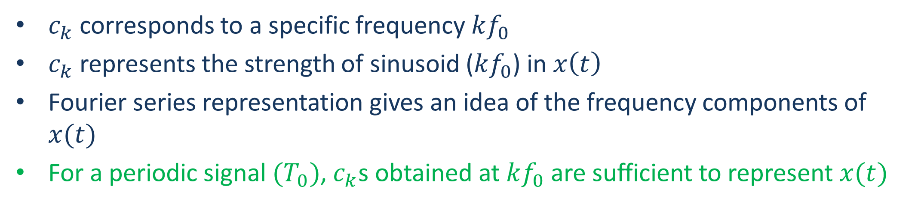
Complex exponential Fourier series representation
$$x\left(t\right)= \sum_{k=−∞}^{∞}{c_{k}e^{jkω_{0}t}}$$
$$c_{k}=\frac{1}{T_{0}}\int_{−\frac{T_{0}}{2}}^{\frac{T_{0}}{2}}{x\left(t\right)e^{−jkω_{0}t}}dt$$
$c_{k}$ corresponds to a specific frequency $kf_{0}$
$c_{k}$ represents the strength of sinusoid ($kf_{0}$) in $x\left(t\right)$
Fourier series representation gives an idea of the frequency components of $x(t)$
For a periodic signal ${(T}_{0})$, $c_{k}$s obtained at $kf_{0}$ are sufficient to represent $x(t)$

Slide 21
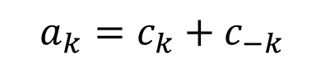
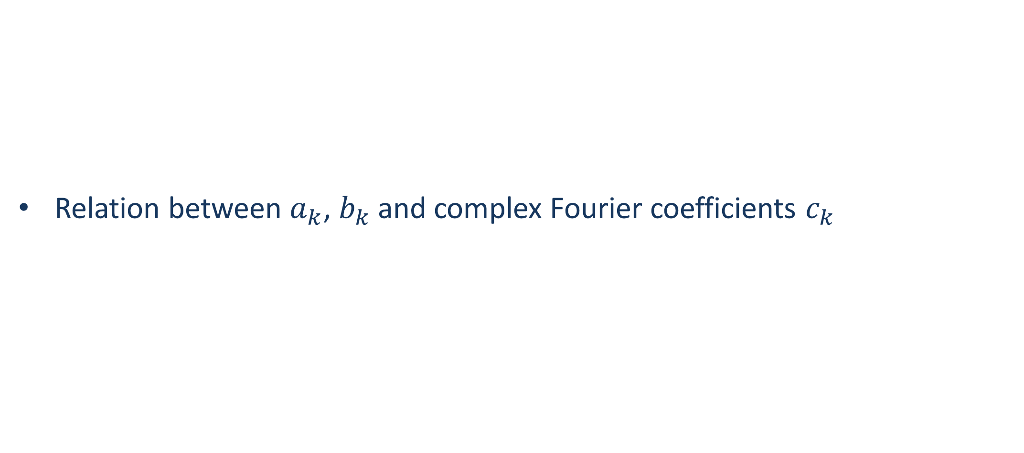
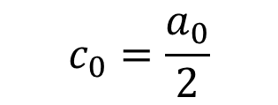
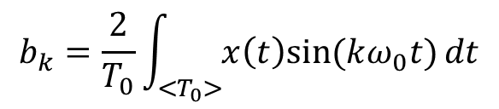
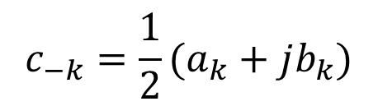
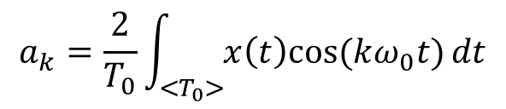
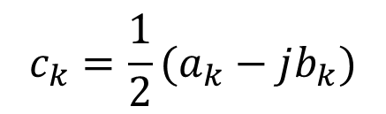
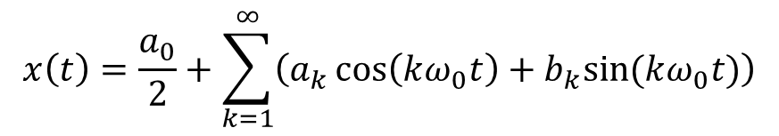
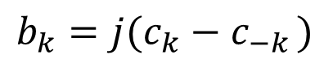
Trigonometric Fourier series representation
Relation between $a_{k}$, $b_{k}$ and complex Fourier coefficients $c_{k}$
$$a_{k}=\frac{2}{T_{0}}\int_{<T_{0}>}{x\left(t\right)cos⁡(kω_{0}t)}dt$$
$$x\left(t\right)=\frac{a_{0}}{2}+\sum_{k=1}^{∞}{\left(a_{k}\cos\left(kω_{0}t\right)+b_{k}sin⁡(kω_{0}t)\right)}$$
$$b_{k}=\frac{2}{T_{0}}\int_{<T_{0}>}{x\left(t\right)sin⁡(kω_{0}t)}dt$$
$$c_{0}=\frac{a_{0}}{2}$$
$$a_{k}=c_{k}+c_{−k }$$
$$b_{k}={j(c}_{k}−c_{−k })$$
$$c_{k}=\frac{1}{2}(a_{k}−jb_{k})$$
$$c_{−k}=\frac{1}{2}(a_{k}+jb_{k})$$

Slide 22
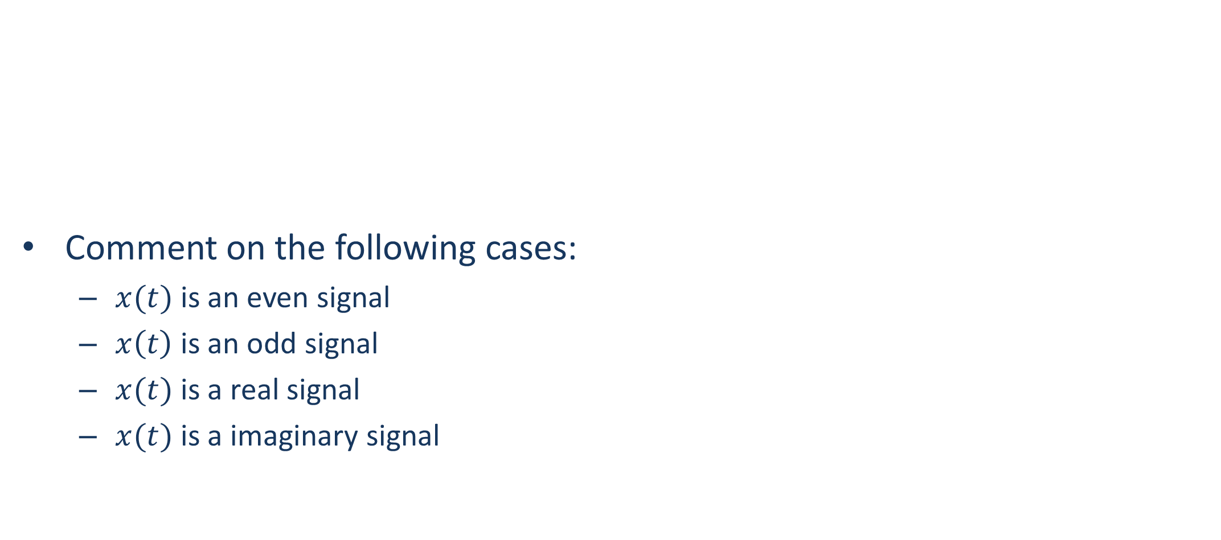
Trigonometric Fourier series representation
Comment on the following cases:
$x(t)$ is an even signal
$x\left(t\right)$ is an odd signal
$x(t)$ is a real signal
$x(t)$ is a imaginary signal
$$a_{k}=\frac{2}{T_{0}}\int_{<T_{0}>}{x\left(t\right)cos⁡(kω_{0}t)}dt$$
$$x\left(t\right)=\frac{a_{0}}{2}+\sum_{k=1}^{∞}{\left(a_{k}\cos\left(kω_{0}t\right)+b_{k}sin⁡(kω_{0}t)\right)}$$
$$b_{k}=\frac{2}{T_{0}}\int_{<T_{0}>}{x\left(t\right)sin⁡(kω_{0}t)}dt$$

Slide 23
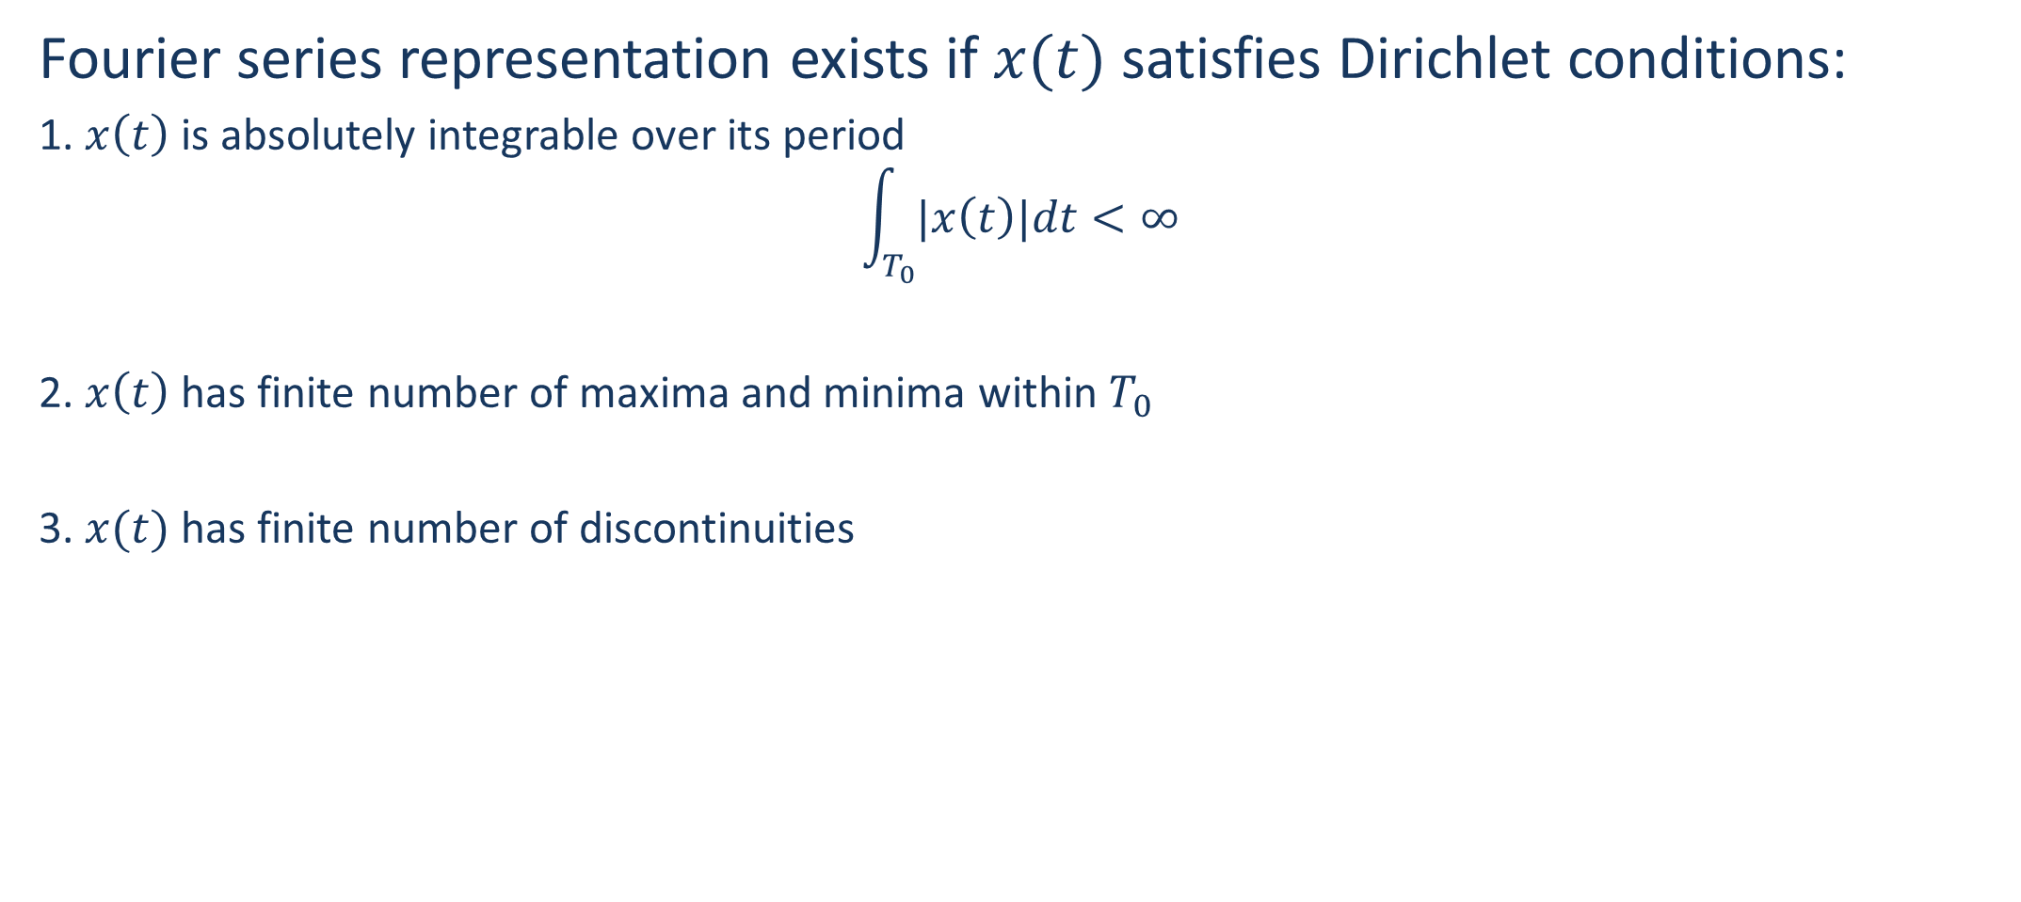
Convergence of Fourier series
Fourier series representation exists if $x(t)$ satisfies Dirichlet conditions:
1. $x\left(t\right)$is absolutely integrable over its period
$$\int_{T_{0}}{|x\left(t\right)|dt}<∞$$
2. $x\left(t\right)$ has finite number of maxima and minima within $T_{0}$
3. $x(t)$ has finite number of discontinuities

Slide 24
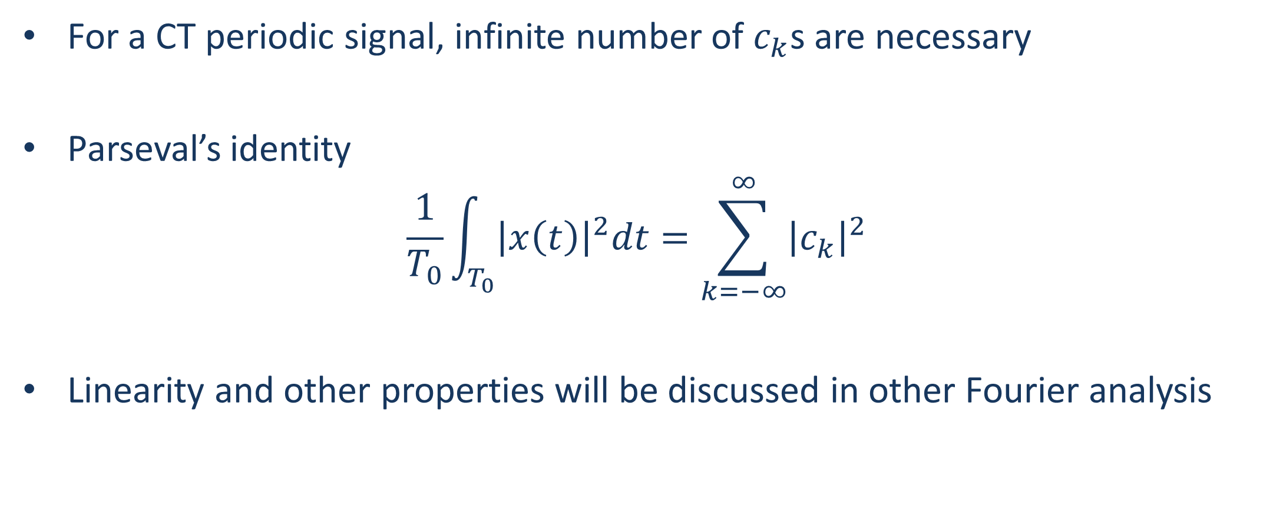
Some interesting pointers
For a CT periodic signal, infinite number of $c_{k}$s are necessary
Parseval’s identity
$$\frac{1}{T_{0}}\int_{T_{0}}{{\left|x\left(t\right)\right|}^{2}dt}=\sum_{k=−∞}^{∞}{{\left|c_{k}\right|}^{2}}$$
Linearity and other properties will be discussed in other Fourier analysis

Slide 25
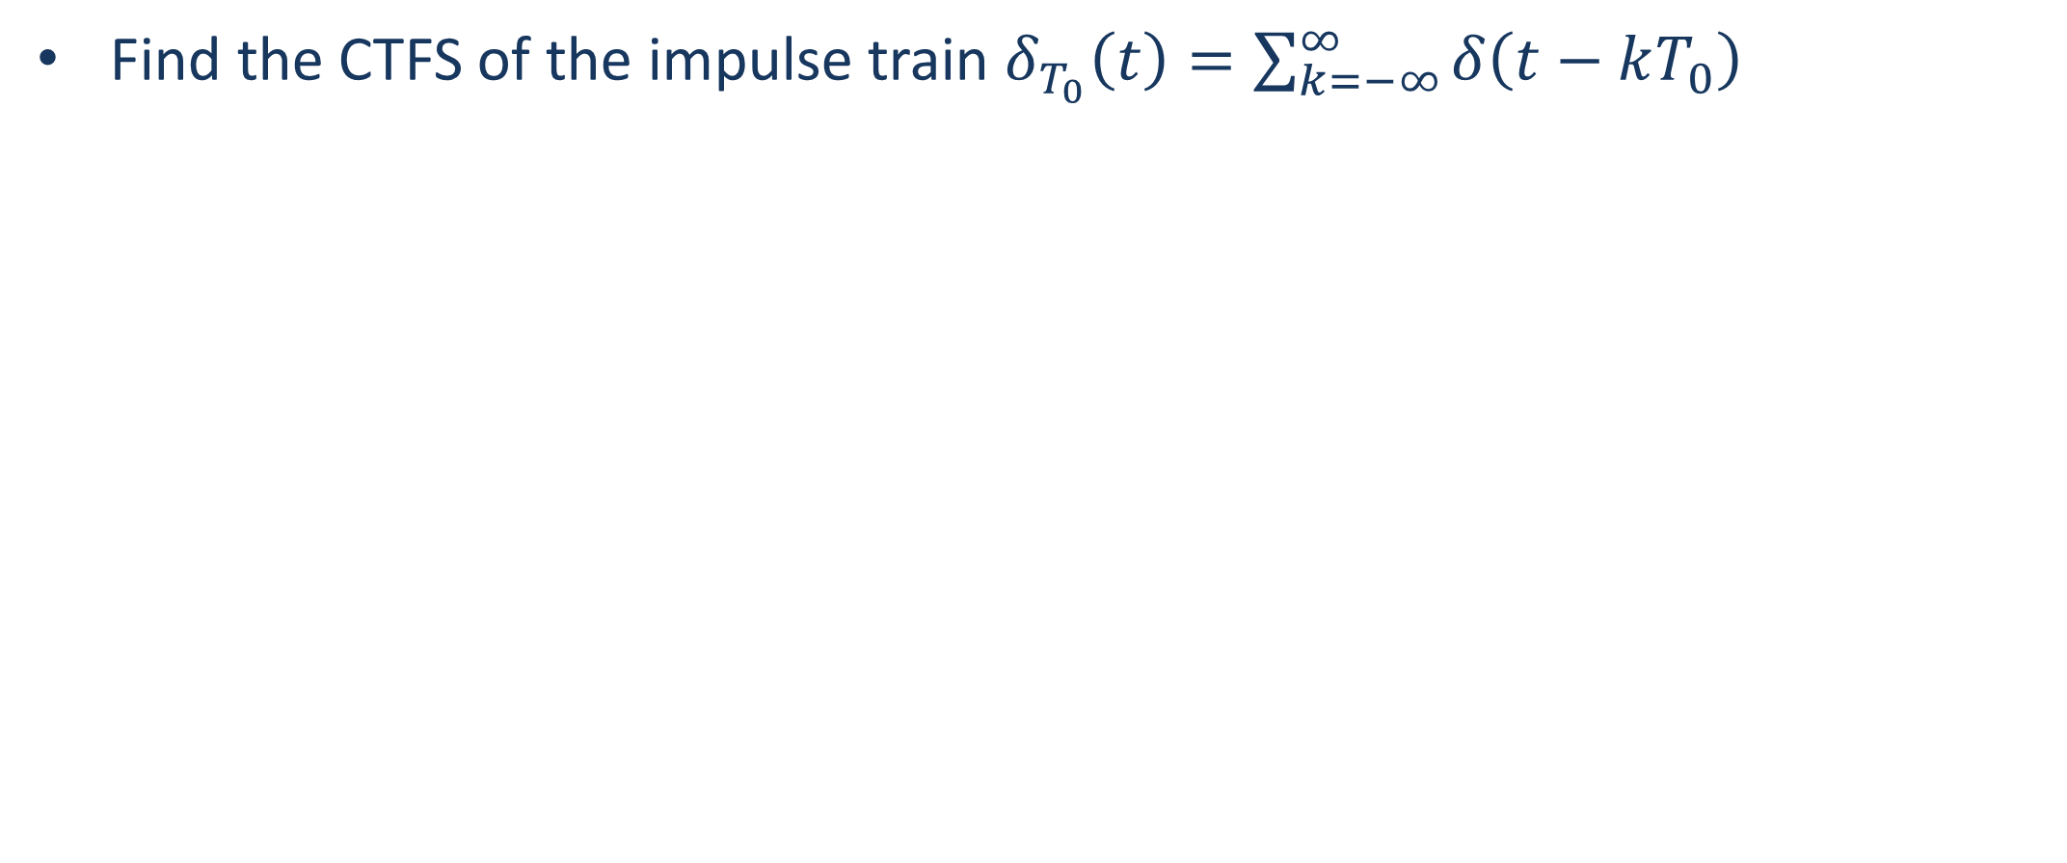
Problem 1
Find the CTFS of the impulse train $δ_{T_{0}}\left(t\right)=\sum_{k=−∞}^{∞}{δ\left(t−kT_{0}\right)}$

Slide 26
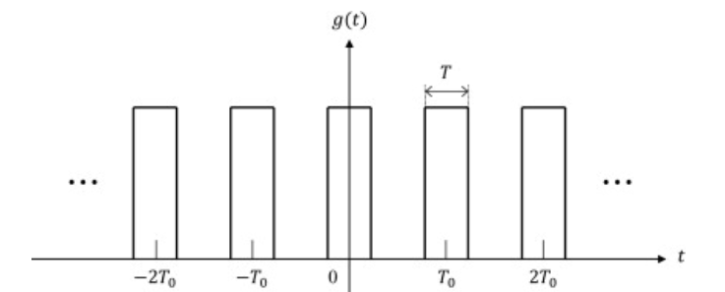

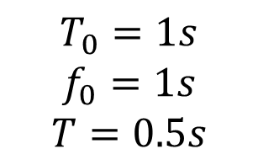
Problem 2
$$T_{0}=1s$$
$$f_{0}=1s$$
$$T=0.5s$$
$$c_{k}= ?$$
Notes:
$$c_{k}=\frac{\sin{2πk/4}}{πk}$$

Slide 27
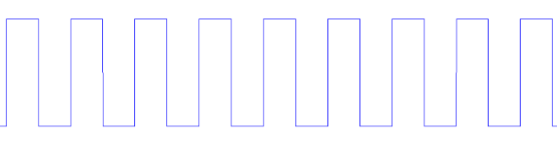
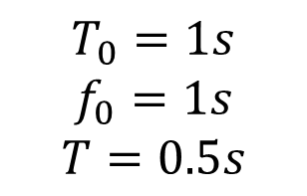
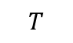
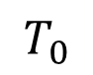
Problem 3
$$T_{0}$$
$$T_{0}=1s$$
$$f_{0}=1s$$
$$T=0.5s$$
$$c_{k}= ?$$
$$T$$
Notes:
$$c_{k}=\frac{e^{\left\{−j2π0.5 k\right\}}−1}{−j2πk}$$

Slide 28
Next: CTFT

